Slide 1

TELECOMMUNICATION CHURN PREDICTION
CUSTOMER CHURN PREDICTION
IN
TELECOM INDUSTRY

Slide 2

AGENDA
INTRODUCTION
PROBLEM STATEMENT
DATASET DESCRIPTION
LIBRARIES
EDA
VISUALIZATION
DATA PREPROCESSING
FEATURE ENGINEERING
MODEL BULDING
MODEL EVALUATION
MODEL DEPLOIMENT
CONCLUSION

Slide 3

INTRODUCTION
Churn prediction is a prominent Big Data application in business, specifically for telecom companies. Its objective is to identify customers who are likely to cancel their subscription services. Churn is a significant concern for telecom providers due to the higher cost associated with acquiring new customers compared to retaining existing ones. The emphasis is on proactively detecting and addressing factors that could lead customers to leave, optimizing strategies to retain them.

Slide 4
PROBLEM STATEMENT
Customer churn poses a significant challenge for telecommunications companies, often experiencing annual churn rates exceeding 10%. In response, these companies actively devise strategies to retain as many clients as possible. This scenario is framed as a classification project, as the predictive variable is binary—indicating whether a customer will churn or remain loyal. The primary objective is to model the probability of churn based on various customer features, utilizing classification algorithms to predict and mitigate potential customer loss in the telecommunications industry.

Slide 5
DATASET DESCRIPTION
The source dataset is in CSV format, facilitating ease of handling and analysis.
The dataset comprises 5000 rows and 21 columns, providing a substantial amount of data for analysis.
"Nan" values are present in the input dataset, indicating missing or undefined values that need to be addressed during data preprocessing.
The variable "Churn" serves as the key indicator, denoting whether a specific customer has churned or remained with the service.
Other independent features in the dataset provide information about the customer's location and details regarding the services they have utilized, offering a comprehensive set of variables for analysis and modeling.

Slide 6
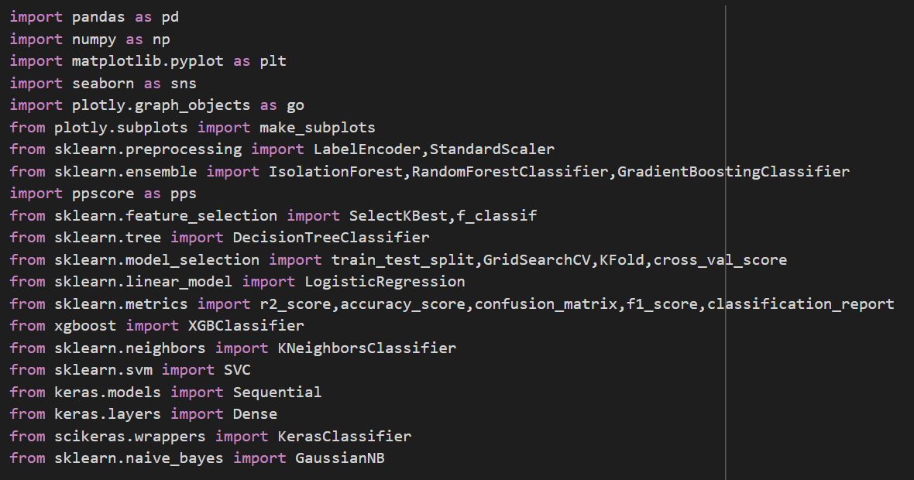
LIBRARIES
Pandas
NumPy
Matplot
Seaborn
Ppscore
Sklearn
Xgboost
Keras
Scikeras
Streamlit
PIL

Slide 7
EXPLORATORY DATA ANALYSIS
Employing Seaborn and Matplotlib libraries to create informative visualizations that enhance the understanding of the dataset.
EDA is an analytical approach aimed at comprehensively examining datasets and summarizing their key characteristics. This process often involves the use of visual methods to uncover patterns, trends, and insights within the data.
While a statistical model may be employed, EDA is primarily focused on extracting meaningful information from data without formal modeling or hypothesis testing. The emphasis is on gaining insights and understanding the inherent patterns in the data beyond the constraints of formal statistical approaches.

Slide 8

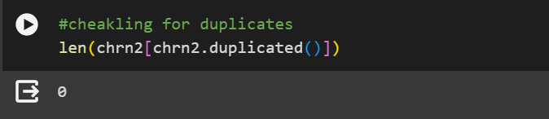
We have dropped redundant columns (i.e. “Unnamed: 0”).
Examined the dataset for any duplicate values.

Slide 9
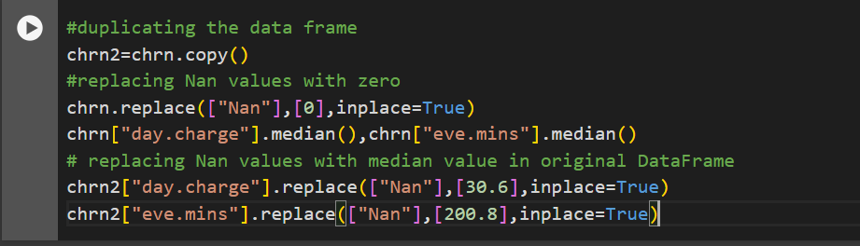
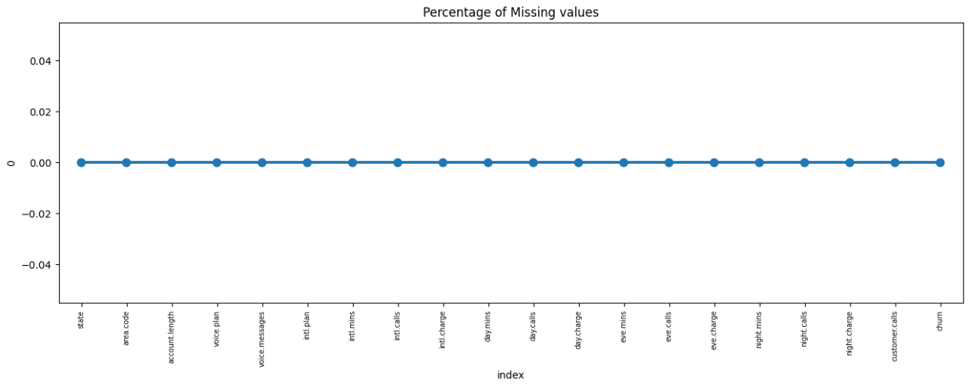
Duplicated the data frame. Replace Nan values with zero in a duplicated Data Frame. Calculate the mean of each column in the duplicated Data Frame. Substitute Nan values in the original Data Frame with the respective mean values.

Slide 10
VISUALISATION
Heat map
Heat map visually represents the magnitude of a variable in a matrix format, using colors to indicate the intensity. It is useful for identifying patterns, correlations, or variations in a dataset
Bar plot
Bar plot displays categorical data with rectangular bars, each representing a category and its corresponding value. It is effective for comparing the magnitude of different categories and spotting trends or variations.
Pie chart
Pie chart illustrates the proportion of each category in a whole by dividing a circle into slices. It provides a clear visualization of the distribution of parts relative to the whole dataset
Scatter plot
Scatter plot shows the relationship between two numerical variables by placing points on a two-dimensional graph. It helps visualize patterns, trends, or correlations between the variables

Slide 11
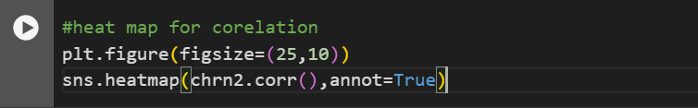
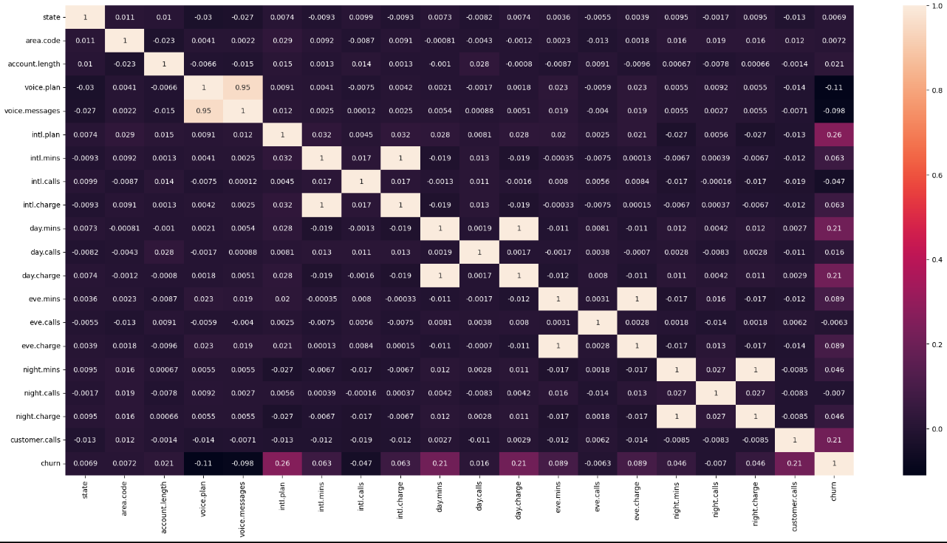
HEAT MAP
The least influential variables in predicting churn are voice plan and international calls, indicating weaker correlations with the likelihood of customer churn.
Customer calls, international plan, day minutes, and day charge exhibit stronger dependencies on the churn variable, suggesting they play a more crucial role in predicting customer churn.

Slide 12
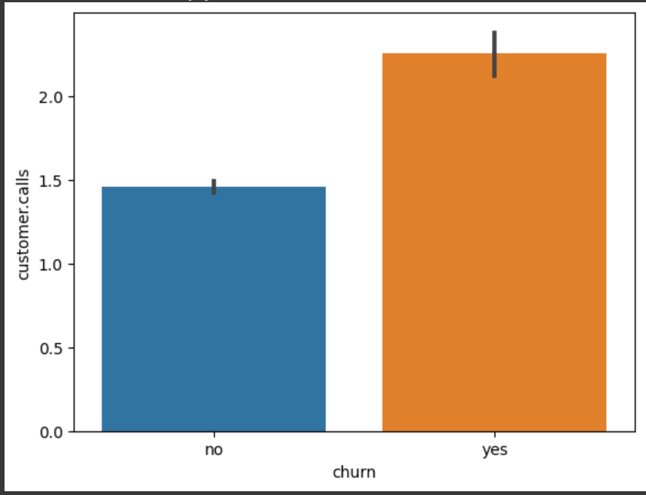
BAR PLOT
The bar plot suggests that customers who tend to churn have higher numbers of calls to customer service compared to customers who do not churn.

Slide 13
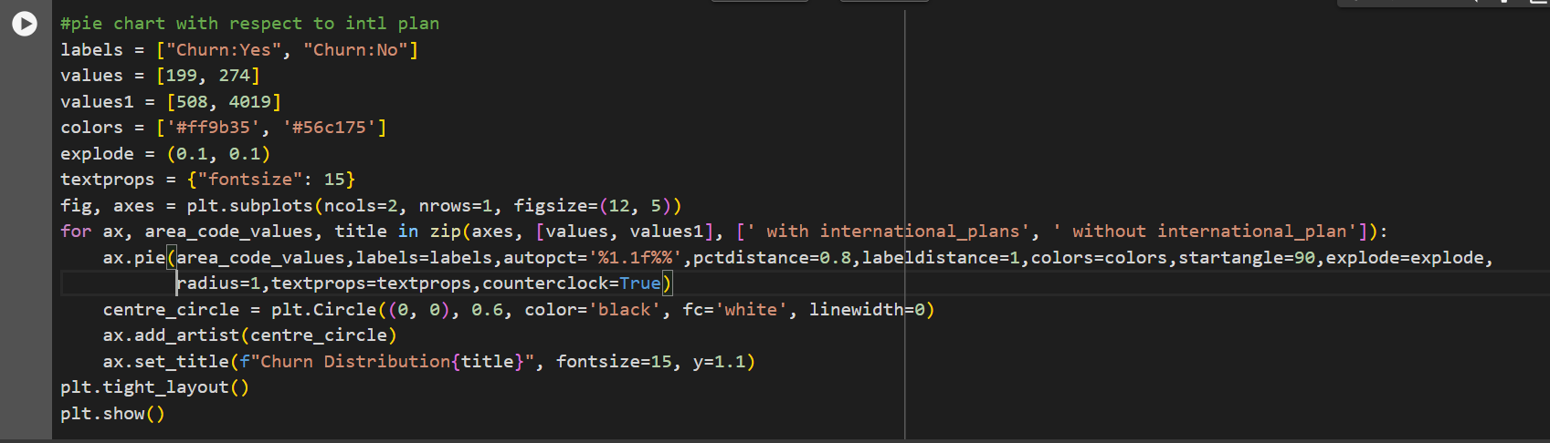
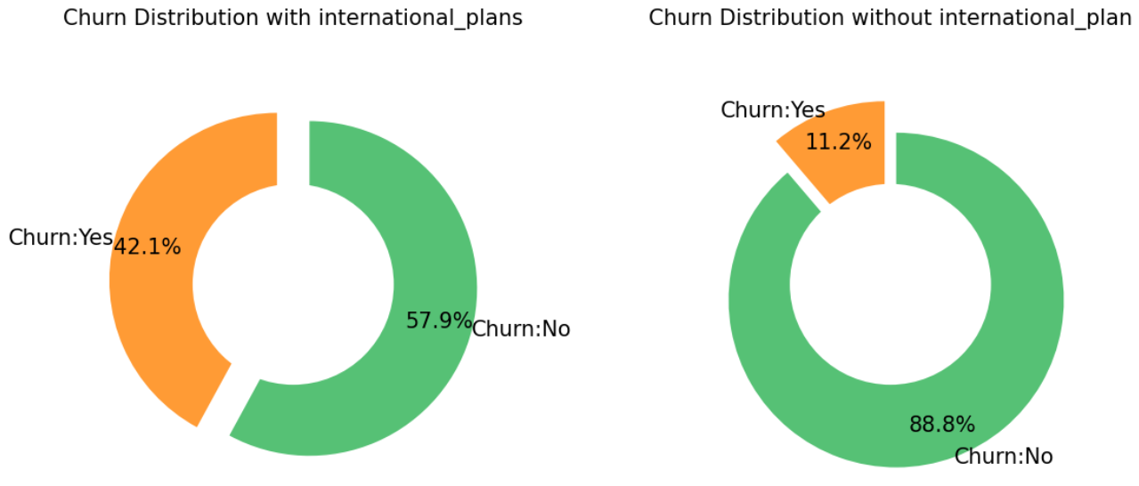
PIE CHART
Customers who subscribed to the international voice plan service are more likely to churn compared to those who did not opt for the international voice plan service

Slide 14
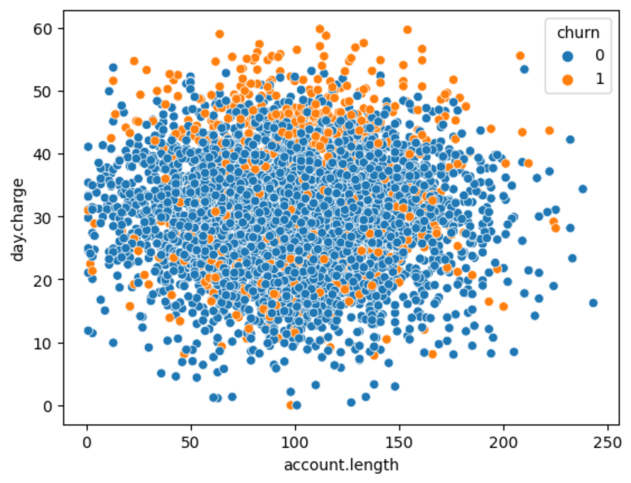
SCATTER PLOT
Customers with a moderate account length, experiencing high day charges, are more likely to churn than both new customers and those who have been with the service for an extended period.

Slide 15
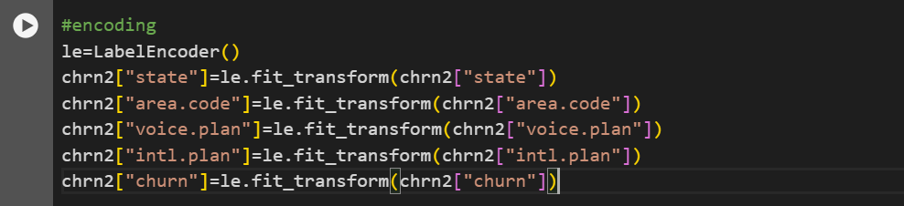
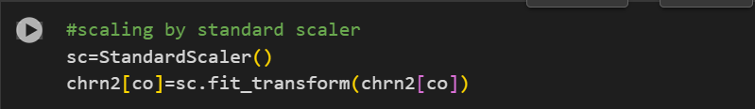
DATA PREPROCESSING
Performed label encoding to convert all object data types to either integers or floats.
Standardizing the data using a standard scaler.

Slide 16
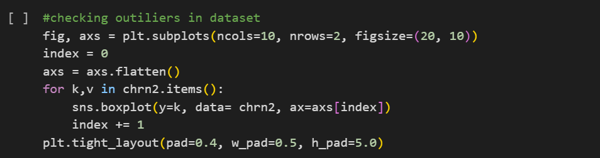
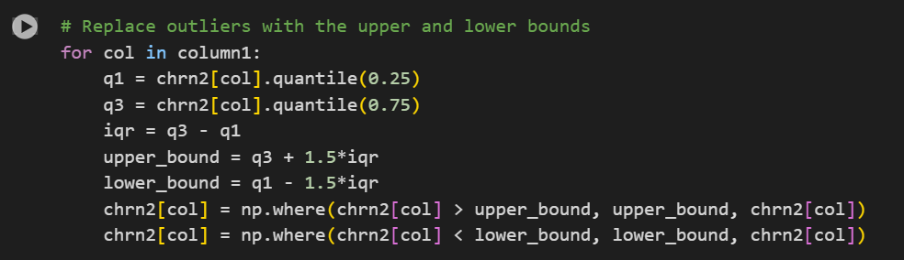
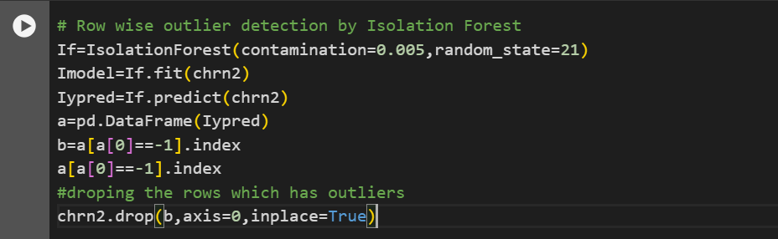
DETECTION AND HANDLING OUTLIERS
Identified the outliers and handled through IQR
Identifying outliers through the isolation forest algorithm and subsequently removing the corresponding rows.

Slide 17
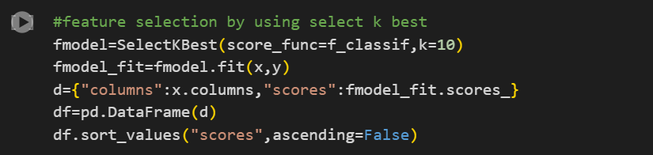
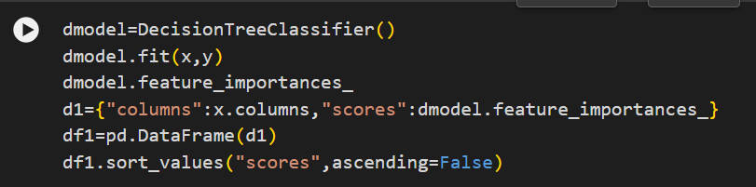
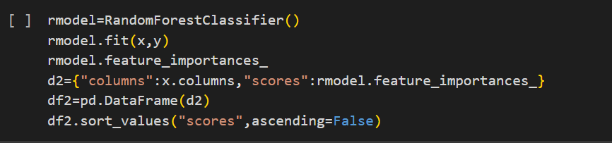
FEATURE ENGINEERING
Identified the less significant features using three feature selection techniques and subsequently eliminated International plan column
1. SELECT K BEST
2. DECISION TREE
3. RANDOM FOREST

Slide 18
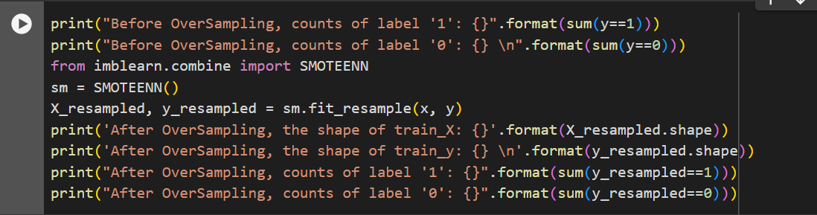
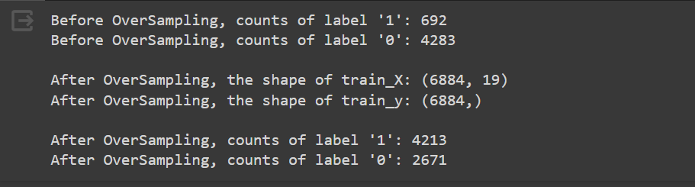
BALANCING DATA
To address the full imbalance in our dataset, we employed a technique known as oversampling with smoothing. This approach involves augmenting the minority class instances in a way that mitigates the class imbalance, ultimately leading to a more balanced dataset.

Slide 19
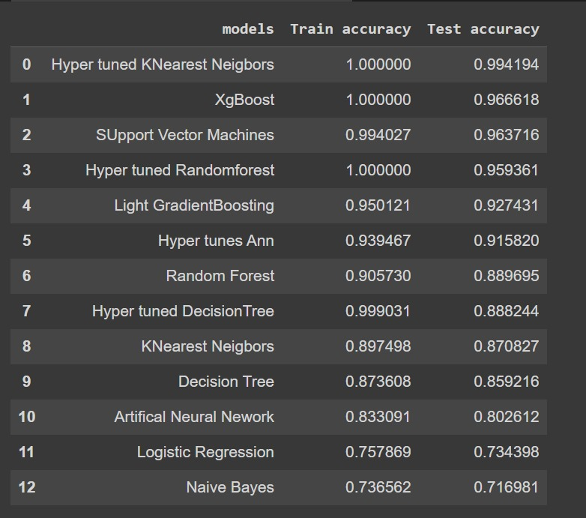
MODEL BUILDING
Model building is crucial in machine learning because it allows computers to learn from data, make predictions, automate tasks, and provide valuable insights. It enables the development of intelligent systems that can adapt and improve their performance over time.
The following models have been utilized for building, accompanied by their respective training and testing accuracies:

Slide 20
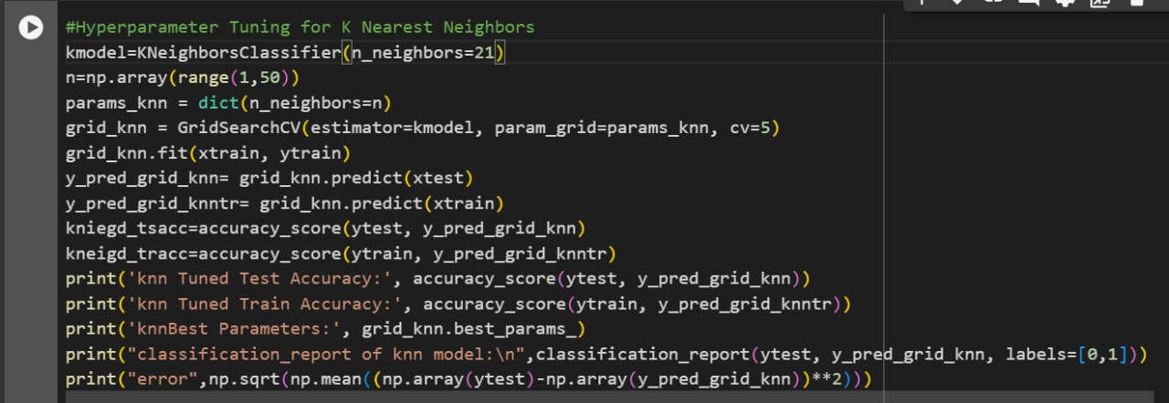
HYPER TUNED K-Nearest Neighbor
We have chosen to deploy the hyper tuned k-nearest neighbors (KNN) model because of its superior accuracy when compared to other models.
The hyper tuned KNN model has achieved very high accuracy on both training and test data.
The optimal number of neighbors was found to be 2.
The model performs equally well across both classes, as indicated by the balanced precision, recall, and F1-scores.
The low error rate further supports the model's strong performance.

Slide 21
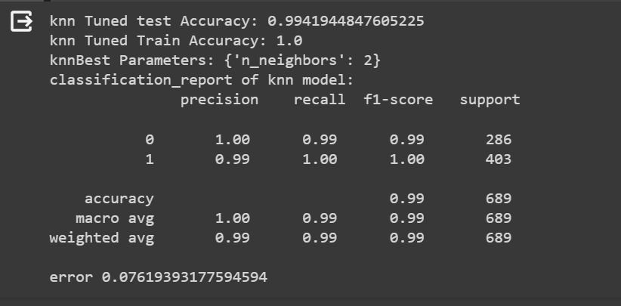
MODEL EVALUATION
Key Performance Metrics:
Test Accuracy: 0.9941944847605225 (excellent performance on unseen data)
Train Accuracy: 1.0 (perfect performance on training data)
Classification Report:
Precision: 1.00 for both classes (high ability to identify true positives without false positives)
Recall: 0.99 for both classes (high ability to identify all true positives)
F1-score: 0.99 for both classes (harmonic mean of precision and recall, indicating balanced performance)
Support: 286 and 403 for the two classes (number of samples in each class)
Overall Accuracy:
Accuracy: 0.99 (overall ability to correctly classify samples)
Macro Average: 0.99 (average of precision, recall, and F1-score across classes)
Weighted Average: 0.99 (weighted average of precision, recall, and F1-score, accounting for class imbalance)
Error:
Error: 0.07619393177594594 (proportion of misclassified samples)

Slide 22
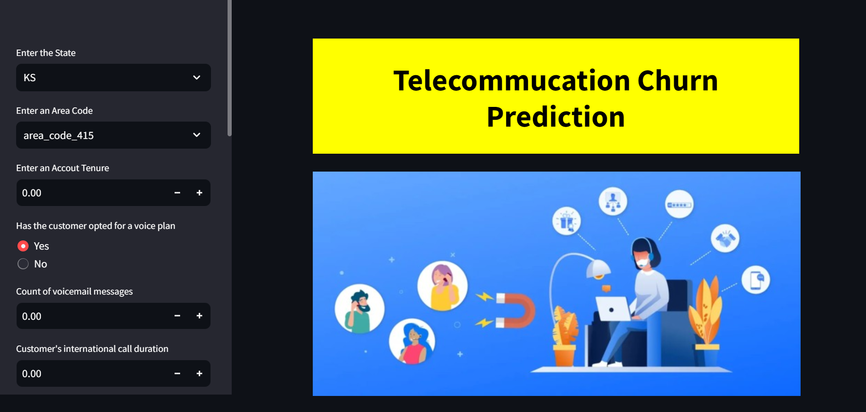
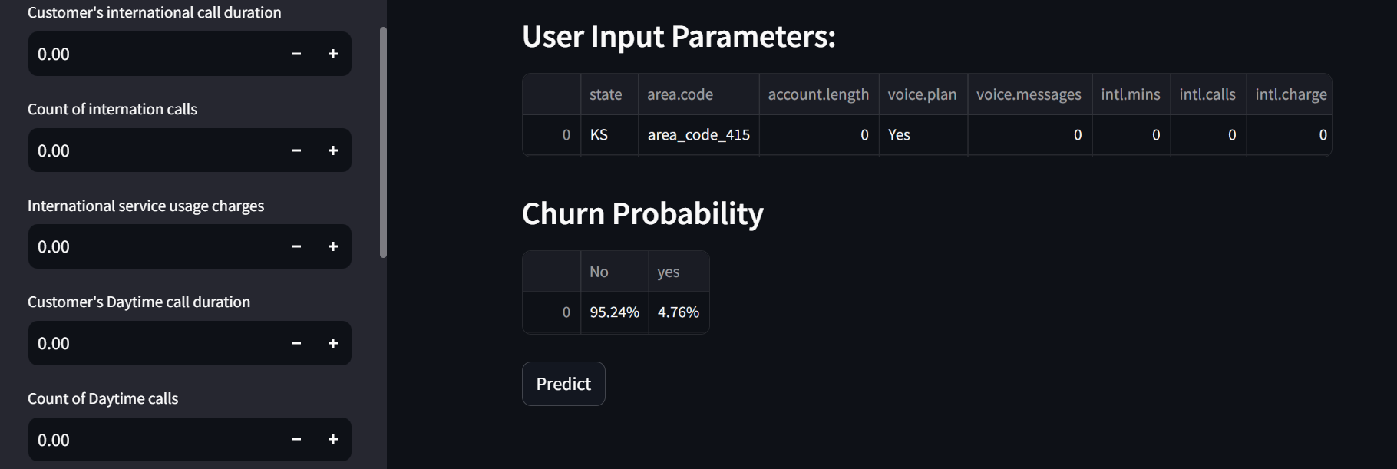
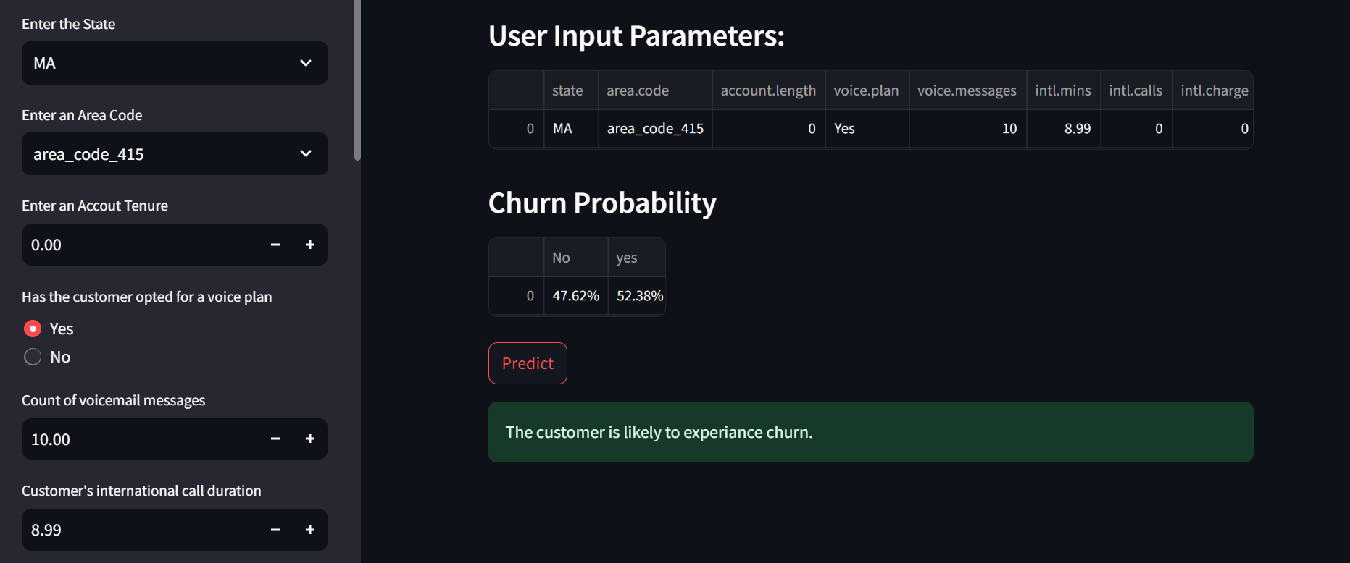
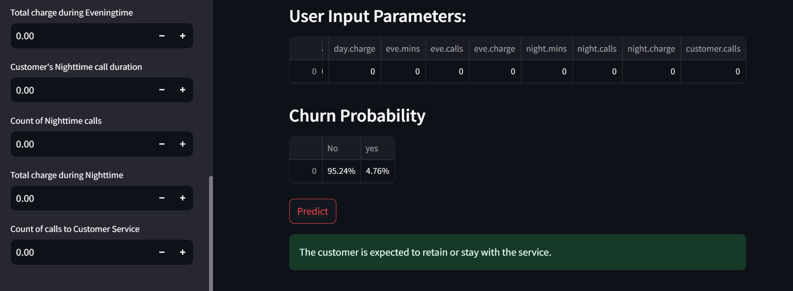
MODEL DEPLOYMENT
The deployment of our model has been successfully executed using Stream lit. Given that the k-nearest neighbors (KNN) model demonstrated impressive accuracy during the development phase, we have opted to leverage the KNN model for deployment. This decision aligns with our commitment to deploying a robust and high-performing solution in real-world scenarios

Slide 23
CONCLUSION
The churn prediction model developed in this project can be instrumental in helping No-Churn Telecom proactively retain customers and improve customer satisfaction.
By identifying customers at risk of churn, targeted retention campaigns can be designed, and personalized offers can be provided to mitigate customer churn.
This can lead to increased customer loyalty, reduced churn rate, and improved business profitability.
Throughout the project, we followed best practices in data science, including data preprocessing, feature engineering, model selection, and performance evaluation. The project highlighted the importance of understanding business objectives, feature engineering, and model selection for solving real-world problems. It also showcased the effectiveness of K Nearest Neighbors in churn prediction tasks

Slide 24


